Slide 1
Oil Price Fluctuations
Subin Kwon
Ao Luo
Alankrit Varma

Slide 2
Agenda
Introduction
History of Oil Price Fluctuations
Measuring Oil Price Expectations
Oil Price Shocks
Problems in Anticipating Price Fluctuations

Slide 3
Introduction

Slide 4
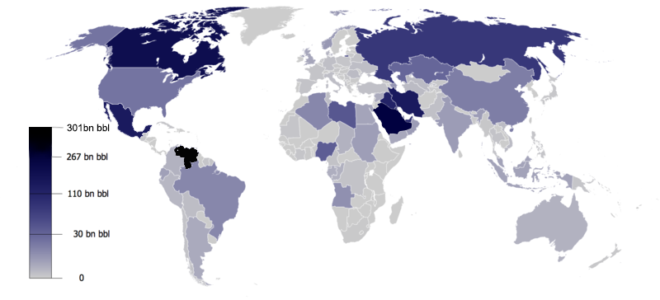
introduction
Crude oil is one of the most important commodities.
The application of crude oil
The crude oil reserve distribution
Notes:
It's an unrefined petroleum product composed of hydrocarbon deposits and other organic materials that can be refined to produce usable products such as gasoline, diesel and various types of petrochemicals.

Slide 5
Major Historical Oil Price Fluctuations

Slide 6
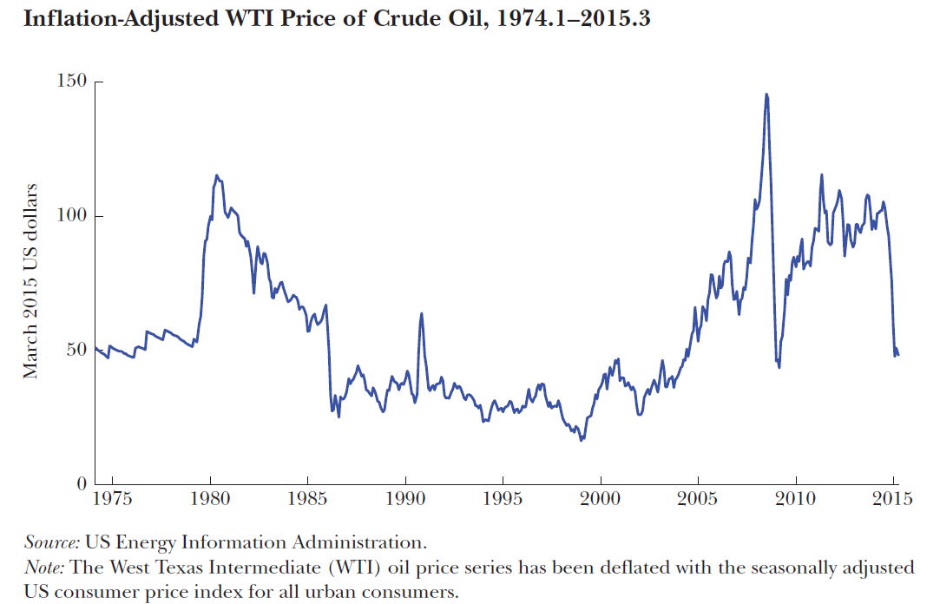
Major Historical Oil Price Fluctuations
Notes:
Add names of each of the shocks in the graph

Slide 7
Prior to 1980, disruptions in global oil production due to exogenous events (wars and revolutions in OPEC countries) were considered to cause major oil price changes
However subsequent research contradicts this claim and categorizes it as just one of the many contributing factors affecting these shifts in the global prices
The most important determinant of the demand for oil has been shifts in the flow (or consumption) demand for oil associated with the global business cycle
As the global economy expands, so does demand for industrial raw materials including crude oil, putting upward pressure on the price of oil

Slide 8
According to the literature the potential determinants of oil price fluctuations include:
Shocks to global crude oil production arising from political events in oil-producing countries, the discovery of new fields, and improvements in the technology of extracting crude oil
Shocks to the demand for crude oil associated with unexpected changes in the global business cycle
Shocks to the demand for above-ground oil inventories, reflecting shifts in expectations about future shortfalls of supply relative to demand in the global oil market
Historically, inventory demand has been high in times of geopolitical tension in the Middle East, low spare capacity in oil production, and strong expected global economic growth.

Slide 9
1973/74 Oil Crisis
Initially attributed to the supply shock due to Israel-Arab war during October 1973
In reality, OPEC countries deliberately cut oil production (~30%) in 1973
Unfavorable term of the 1971 Tehran/Tripoli agreement was the major factor behind these cuts
Price agreed upon in 1971 quickly eroded in real terms as a result of a depreciating US dollar and rising US inflation
The decision to reduce oil production and raising of the oil price was motivated by the cumulative effects of the dollar devaluation, unanticipated US inflation, and high demand for oil fueled by strong economic growth
Hence, price increase was endogenous with respect to global macroeconomic conditions
Notes:
Compared with non-oil inflation, 25% of price increase was as a result of supply shocks

Slide 10
1979/80 Oil Crisis
The price of WTI crude oil rose from less than $16 per barrel in April 1979 to almost $40 in April 1980
Traditional view faults the reduced output following the Iranian revolution
But most of the shortfall was covered by Saudi Arabia’s increased output in response to the revolution. The Iranian production also started recovering from May 1979
Thus, this oil supply shock is not sufficient in completely explaining the 1979 oil price increase
Empirical evidence credits only 1/3 of the increase to anticipation of future oil shortages, reflecting adverse geopolitical conditions
Majority (2/3) of the cumulative oil price increase is explained by the demand shocks triggered by an unexpectedly strong global economy

Slide 11
1980’s and 1990’s
1981 witnessed an increase in the WTI price of oil from $36 per barrel to $38 in January 1981 due to the outbreak of the Iran–Iraq War (supply shock)
However, early 1980s saw a systematic decline in the price of oil due to a more contractionary stance in global monetary policy regimes
Paul Volcker’s decision to raise US interest rates lowered the demand for oil (demand shock)
Additionally, non-OPEC countries had expanded their production capacities following the first oil crisis pulling down the oil prices
Demand for crude reduced, arguably caused by the Asian financial crisis of mid-1997, followed by economic crises in Russia, Brazil, & Argentina ($11 per barrel)
Recovery in prices started in 1999, attributed to Venezuelan production drop and 2003 Iraq war

Slide 12
2003 to global financial crisis
Between mid-2003 and mid-2008 the WTI price climbed from $28 to $134 per barrel caused by increases in the demand associated with an unexpected expansion of the global economy
An alternative view is that this surge in the price of oil was the result of speculative positions taken by financial traders in the oil futures market
However in mid-2008 the demand plummeted anticipating recession, with prices settling at $39 per barrel in February 2009
The price of oil stabilized near $100 per barrel when fear of global financial system collapse subsided
Between June 2014 and January 2015 the Brent price of oil fell from $112 to $47 per barrel
The contributing factors for this were slowdown in global economic activity ($11), unexpected increase in production in US, Canada, & Russia ($16), and unanticipated weakening of the economy in late 2014 ($13)

Slide 13
Measuring Expectations

Slide 14
How to measure oil price expectations
Economists’ Oil Price Expectations
Policymakers’ Oil Price Expectations
Financial Market Oil Price Expectations
Consumers’ Oil Price Expectations

Slide 15
Economists’ Oil Price Expectations
Relating the price of oil to its own past values as well as past values of other key determinants of the price of oil suggested by economic theory.
The central idea underlying vector autoregression(VAR) models of the global oil market.

Slide 16
Policymakers’ Oil Price Expectations
One possibility - Financial market participants have more information than can be captured by econometric models. It is equally possible for financial market participants to ignore, misinterpret, or miss information captured by model-based oil price predictions, especially if that information is costly to obtain.
A natural source of information about the market expectation of the price of oil is the price of oil futures contracts.
The most common approach to inferring the expected price of oil for immediate delivery in the physical market has been to treat the price of the oil futures contract of maturity h as the h-period ahead market expectation of the nominal price of crude oil.
This is how the International Monetary Fund forms oil price expectations, and this has been common practice at many central banks in the world. This is why this approach is referred as the policymakers’ oil price expectation.

Slide 17
Financial Market Oil Price Expectations
The use of futures prices as measures of market expectations is valid only if the risk premium is negligible.
There is a large horizon-specific time-varying risk premium in the oil futures market.
The oil price expectation may be recovered by subtracting the Hamilton-Wu estimates of the risk premium from the oil futures price for a given horizon.

Slide 18
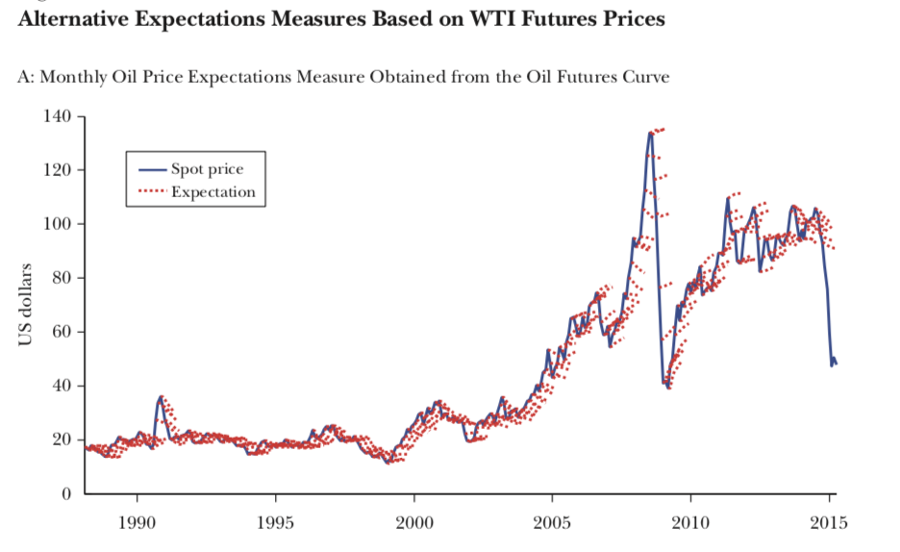

Slide 19
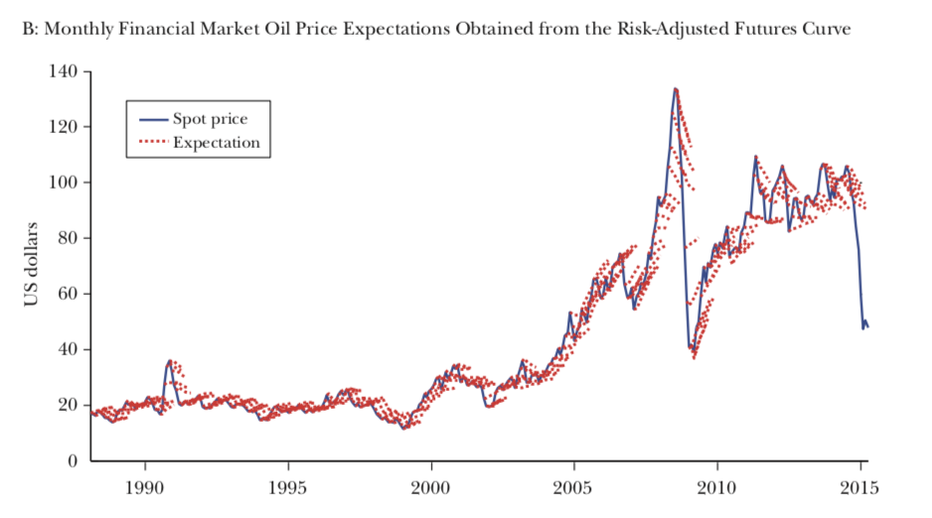

Slide 20
Consumers’ Oil Price Expectations
Recent research has shown that households in the Michigan Survey of Consumers typically form expectations about the real (or inflation-adjusted) price of gasoline according to a simple no-change model such that the nominal gasoline price is expected to grow at the rate of inflation.
Consumers forecast the real and nominal prices of crude oil along much the same lines, allowing us to proxy consumer expectations about the nominal price of oil based on the current price of oil and an inflation forecast.

Slide 21
Oil Price Shock

Slide 22
What is an oil price shock
Unanticipated or surprise component of a
How to measure? What benchmark?
Four comparisons
Perceived by financial markets
Perceived by policymakers
Perceived by consumers
Measured by economists (VAR Model)
Notes:
Whether it happens
How large is the shock

Slide 23
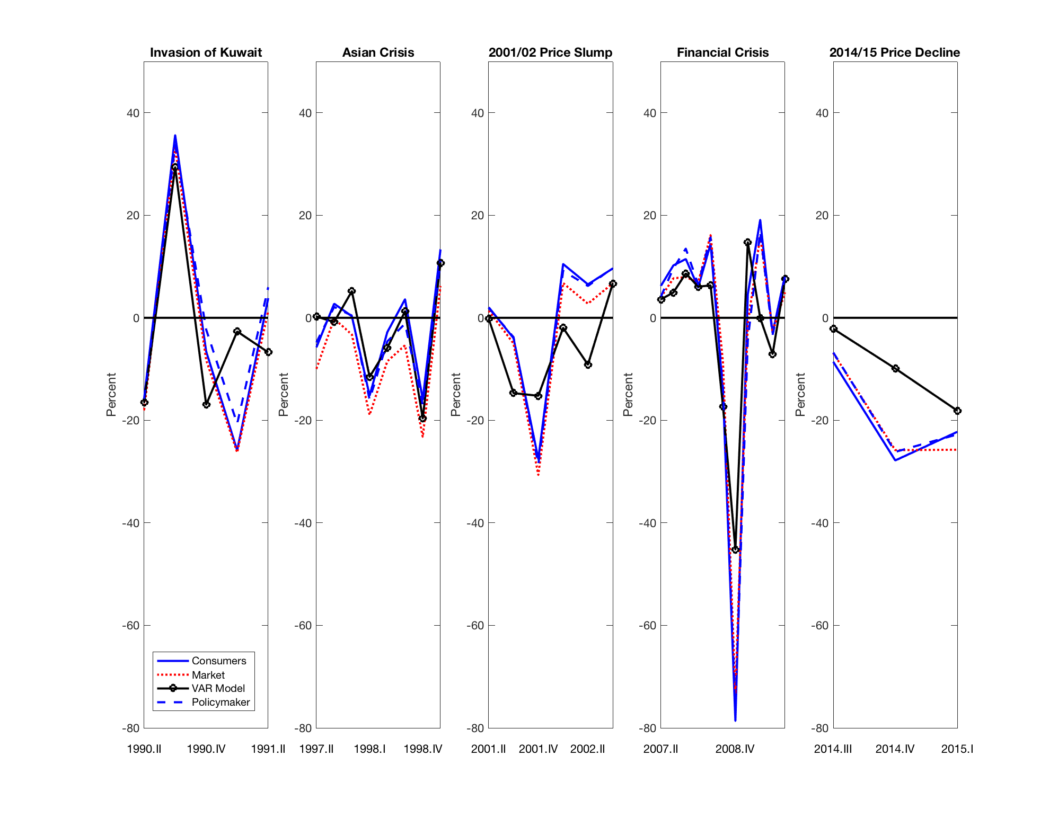
Quarterly shocks to nominal wti price of oil by episode
Notes:
VAR on average predict the shocks best
Overall, shocks are largest from consumer’s perspective
Somewhat smaller from financial market perspective
Policymakers’ expectation close to consumers’ expectations.
Shock = - (expectation - spot) / spot

Slide 24
Heterogeneity in oil price expectations
VAR on average predict the shocks best
Overall, shocks are largest from consumer’s perspective
Somewhat smaller from financial market perspective
Policymakers’ expectation close to consumers’ expectations.

Slide 25
Shock = - (expectation - spot) / spot
Notice the most persistent surge in price of oil occurred between 2003 and mid-2008
Which lies in the gap between 2001/02 price slump shock and financial crisis shock
No large positive oil price shocks necessary to sustain increase in the price of oil

Slide 26
Difficulties in Prediction

Slide 27
Can we predict oil price fluctuation?
The answer is yes. But the performance is poor
We know what are the determinants
Demand shift associated with growth,
supply shift associated with production
inventory demand
We don’t know the future evolution of these determinants
Notes:
After so many of talks, we have roughly understand the determinants of past oil price fluctuations
Can we do prediction?

Slide 28
Demand shifts associated with the global business cycle
World GDP
Global real economic evolution of global business cycle
Prediction only for short horizons but very imprecise
The accuracy of VAR for oil price improves under persistent economic expansions or contractions (i.e., predictable), but greatly reduced during normal times
e.g., China’s industrialization since 2003

Slide 29
Supply shifts associated with the Oil Production
Unpredictable disruptive political events in oil-producing countries
Gauge the response of global oil production to surges in the price of oil driven by increased demand for crude oil
Replaceable?
Notes:
1980’s oil search
Oil-peak hypothesis
Shale oil extraction technology

Slide 30
Inventory demand shifts
Oil price changes in response to a shift in uncertainty
The prediction of timing of political crises and their impact
Eg. Arab Spring
The prediction of timing of economic crises
Most predictions simply ignore the possibility of future political or economic crises: because crises are rare.
Notes:
Empirically, shifts in inventory demand tend to arise only when geopolitical turmoil coincides with expectations of strong demand for crude oil and light oil supplies.
Geopolitical tensions alone, will not have an effect on the price of oil as long as oil supplies are plentiful relative to expected demand.

Slide 31
Q&A
“Oil.” - ???

Slide 32
Thank you

